Slide 1
Fast Food Restaurants - EDA
This is a list of over 10,000 fast food restaurants provided by Datafiniti's Business Database. The dataset includes the restaurant's address, city, latitude, longitude cordinates, name and more.
We will analyse the below details about this data.
a. Explore the concentratio of the restaurants accross the regions.
b. Which restaurant has highest numbers of stores in provices and cities?
c. Identify the area where new restaurants can be setup.
d. Identify the pattern of restaurant location across the cities?
e. How restaurant location affects the preferences of the consumers?

Slide 2
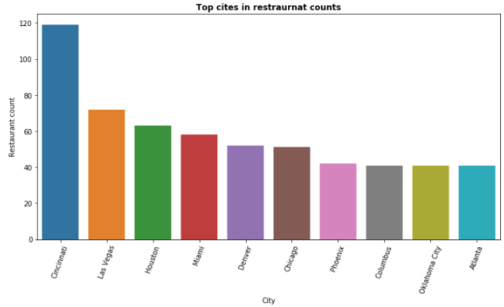
Which city have highest number of restaurants in US?

Slide 3
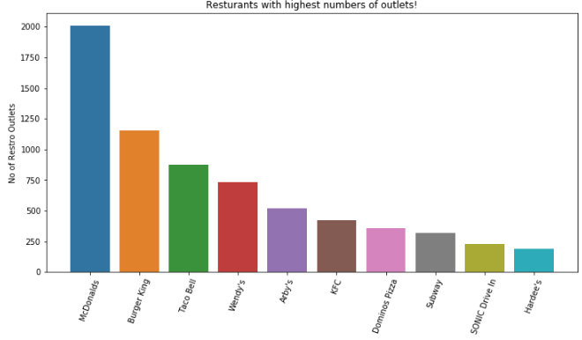
Which restaurants have highest number of outlets in US?

Slide 4
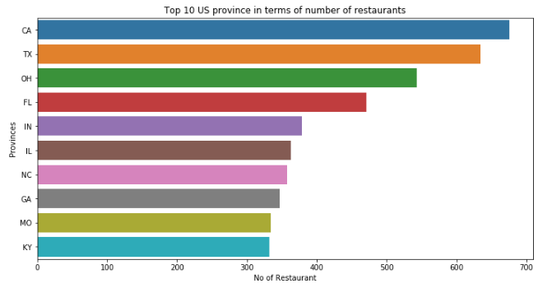
Which province have highest number of restaurants in US?

Slide 5
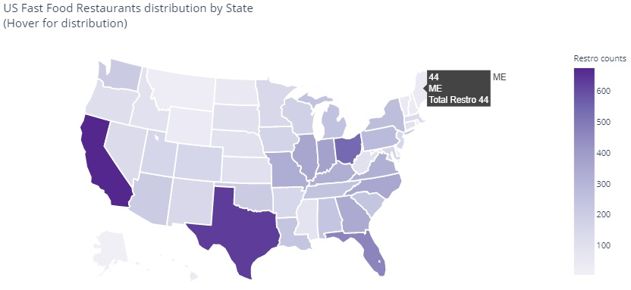
Graphical Display of Restaurant by States
Highest number of fast food restaurant are found in California, followed by Texas.

Slide 6
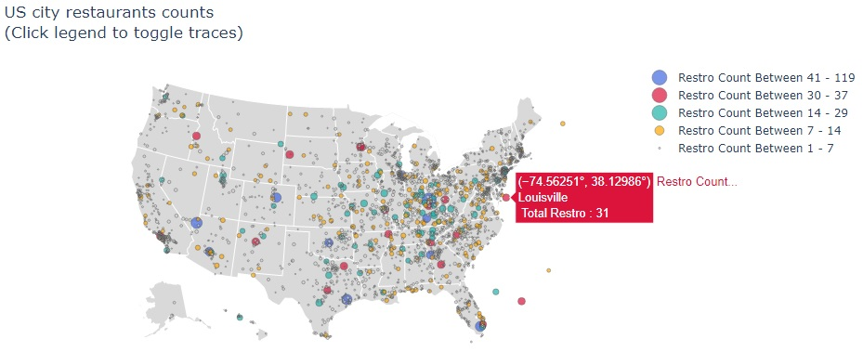
Distribution of Fast Food Restaurants across the US cites.
With above figure it is easy to figure out wich city provide the busness apportunity for the restaurant business.

Slide 7
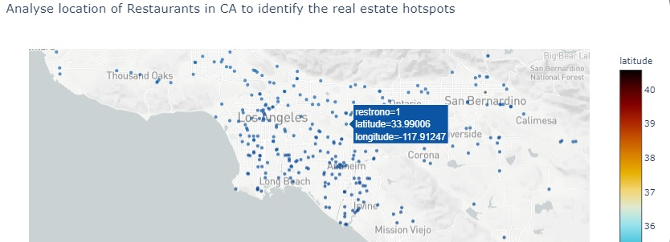
Analyse the geographical distribution of restaurant to speculate real estate hotspots.
With above diagrame, we can figure out the locality where the real estate prices are high,
low or medium based on the concentration of the restaurants. This is just one dimension
to it. There could be more parameter to find real estate hotspots.

Slide 8
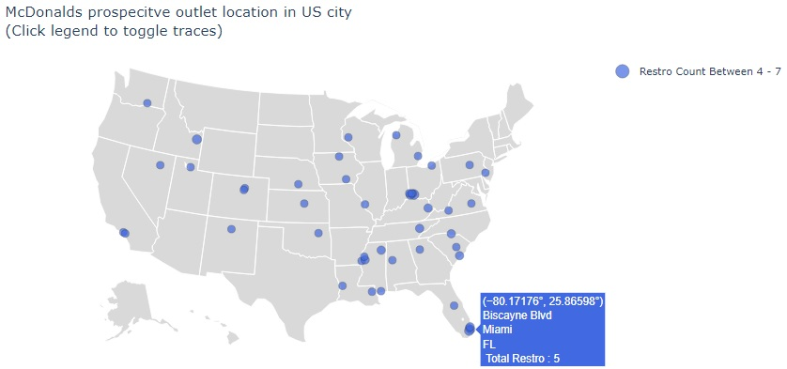
Prospective Outlet location
As a strategy to expansion, the restaurant outlets like McDonlads can use above details to setup new outlets based on the existing restaurants patterns. In locality with high concentration of restaurants, most of the time provide good business opportunity for established food chain.

Slide 9
Thank You

